Slide 1
Mass Shooting Prediction Using Time Series
DATA 270: Data Analytics Process
Group 5:
Hruthik Vinnakota
Jugal Kishore Ruvva
Rajeev Yenugula
Shilpa Bai

Slide 2
OBJECTIVE
The main goal is to examine the historical patterns, trends, and seasonality of mass shootings in order to create prediction models for predicting upcoming events.

Slide 3

INTRODUCTION
This project aims to predict future mass shootings in the United States using time series forecasting with several machine learning models. The models will analyze past shootings data to forecast the likelihood of future occurrences.
Ultimately, the goal is to empower communities to create a safe environment for their citizens and reduce the prevalence of mass shootings.

Slide 4
PROJECT BACKGROUND
Mass shootings in the US have become a recurring issue.
Researchers are using data-driven methods to analyze trends and predict future occurrences.
Time series forecasting helps identify patterns in the data to make predictions based on past observations.
Time series forecasting, which uses a variety of models, aids in the discovery of trends and the development of prediction models.

Slide 5
THE MOTIVATION AND PROBLEM
The cause for this research project is the increasing frequency and severity of mass shootings, which pose a significant threat to public safety.
However, Lack of knowledge regarding the underlying dynamics of these accidents prevents effective proactive and intervention efforts.
The issue being addressed is the lack of thorough analysis and forecasting models to pinpoint temporal trends and likely causes of mass shootings.
Need for improved insights and predictions for informing policy and practice.

Slide 6
PROJECT DELIVERABLES
The project deliverables include the concept of the project, data comprehension, extraction of data, work breakdown structure (WBS), data set analysis, fabrication of models, conclusion, and research presentation at the end.
Each deliverable has a specific description and a due date.
A WBS outlines the tasks and responsibilities of team members, and the data set analysis involves preliminary analysis of the data to prepare it for modeling.
The fabrication of models includes model construction, training, and evaluation of model metrics, while the conclusion provides insights and potential applications of the project.
Finally, the research presentation at the end is a formal presentation of the project report.

Slide 7
TECHNOLOGY AND SOLUTION SURVEY
PAPER TITILE | AUTHORS | DATASET | MODELS | RESULTS | SUMMARY
Crime Forecasting: A Theoretical Approach | Anuvarshini S R, Deeksha Nidhi, Deeksha Sree C, & Krishna Sowjanya K | Boston city criminal records | Decision Tree, KNN, AdaBoost, Random Forest, Light Gradient Boosting, Gradient Boosting, ARIMA & SARIMA | 89 | Using time series analysis, this research proposes a theoretical method for predicting mass shootings
Purchasing firearms after mass shootings: a time-series analysis | Gina Liu and Douglas J. Wiebe | Firearm purchase records | Logistic regression, ARIMA and SARIMA | 38.7% | The authors investigate whether mass shooting events influence firearm purchasing behavior.
Urban crime prevention using cluster detection analysis | Zeoli et al. | Homicide data from Newark Police Department Homicide Unit | Cluster detection software | 116 | The study employed cluster detection to identify high-conflict streets for urban crime prevention.

Slide 8
TECHNOLOGY AND SOLUTION SURVEY
PAPER TITILE | AUTHORS | DATASET | MODELS | RESULTS | SUMMARY
A comparative ml study time series oil production forecasting | Ning Y, Kazemi H,Tahmasebi P | Oil production data | ARIMA, LSTM, Prophet | 23.8 | Various machine learning models were evaluated for forecasting time series oil production.
Long Short-Term Memory Networks for Time Series Prediction | Lindemann et al | Research papers | LSTM | NA | A survey found that LSTM networks are effective in controlling time series, but are limited by computational costs and overfitting
A Comparative Study of Profit Prediction in Time Series Forecasting | M. Sirisha, M. C. Belavagi, and G. Attigeri. | Company profits | ARIMA, SARIMA, LSTM | 75% | The LSTM model performed better than ARIMA and SARIMA in predicting future profits.

Slide 9
PROJECT REQUIREMENTS
DATA REQUIREMENTS
MODELS
TUNING
IDENTIFICATION
Key Requirements
Use supervised learning algorithms such as VAR, SARIMA, LSTM, and Prophet.
Analyze and forecast data gathered over time using time series analysis.
Identify trends, patterns, periodicity, and seasonality in data.
Train models on appropriate data and tune hyperparameters to minimize error and prevent overfitting.

Slide 10
PROJECT REQUIREMENTS
FEATURE ENGINEERING
MODEL EVALUATION
REFINE MODEL
DEPLOYMENT
Key Requirements
Based on evaluation feedback update the model
Feature engineering to extract relevant and meaningful features from raw time series data.
Evaluate model performance using metrics such as MAE, RMSE
Monitor performance and final documentation.

Slide 11
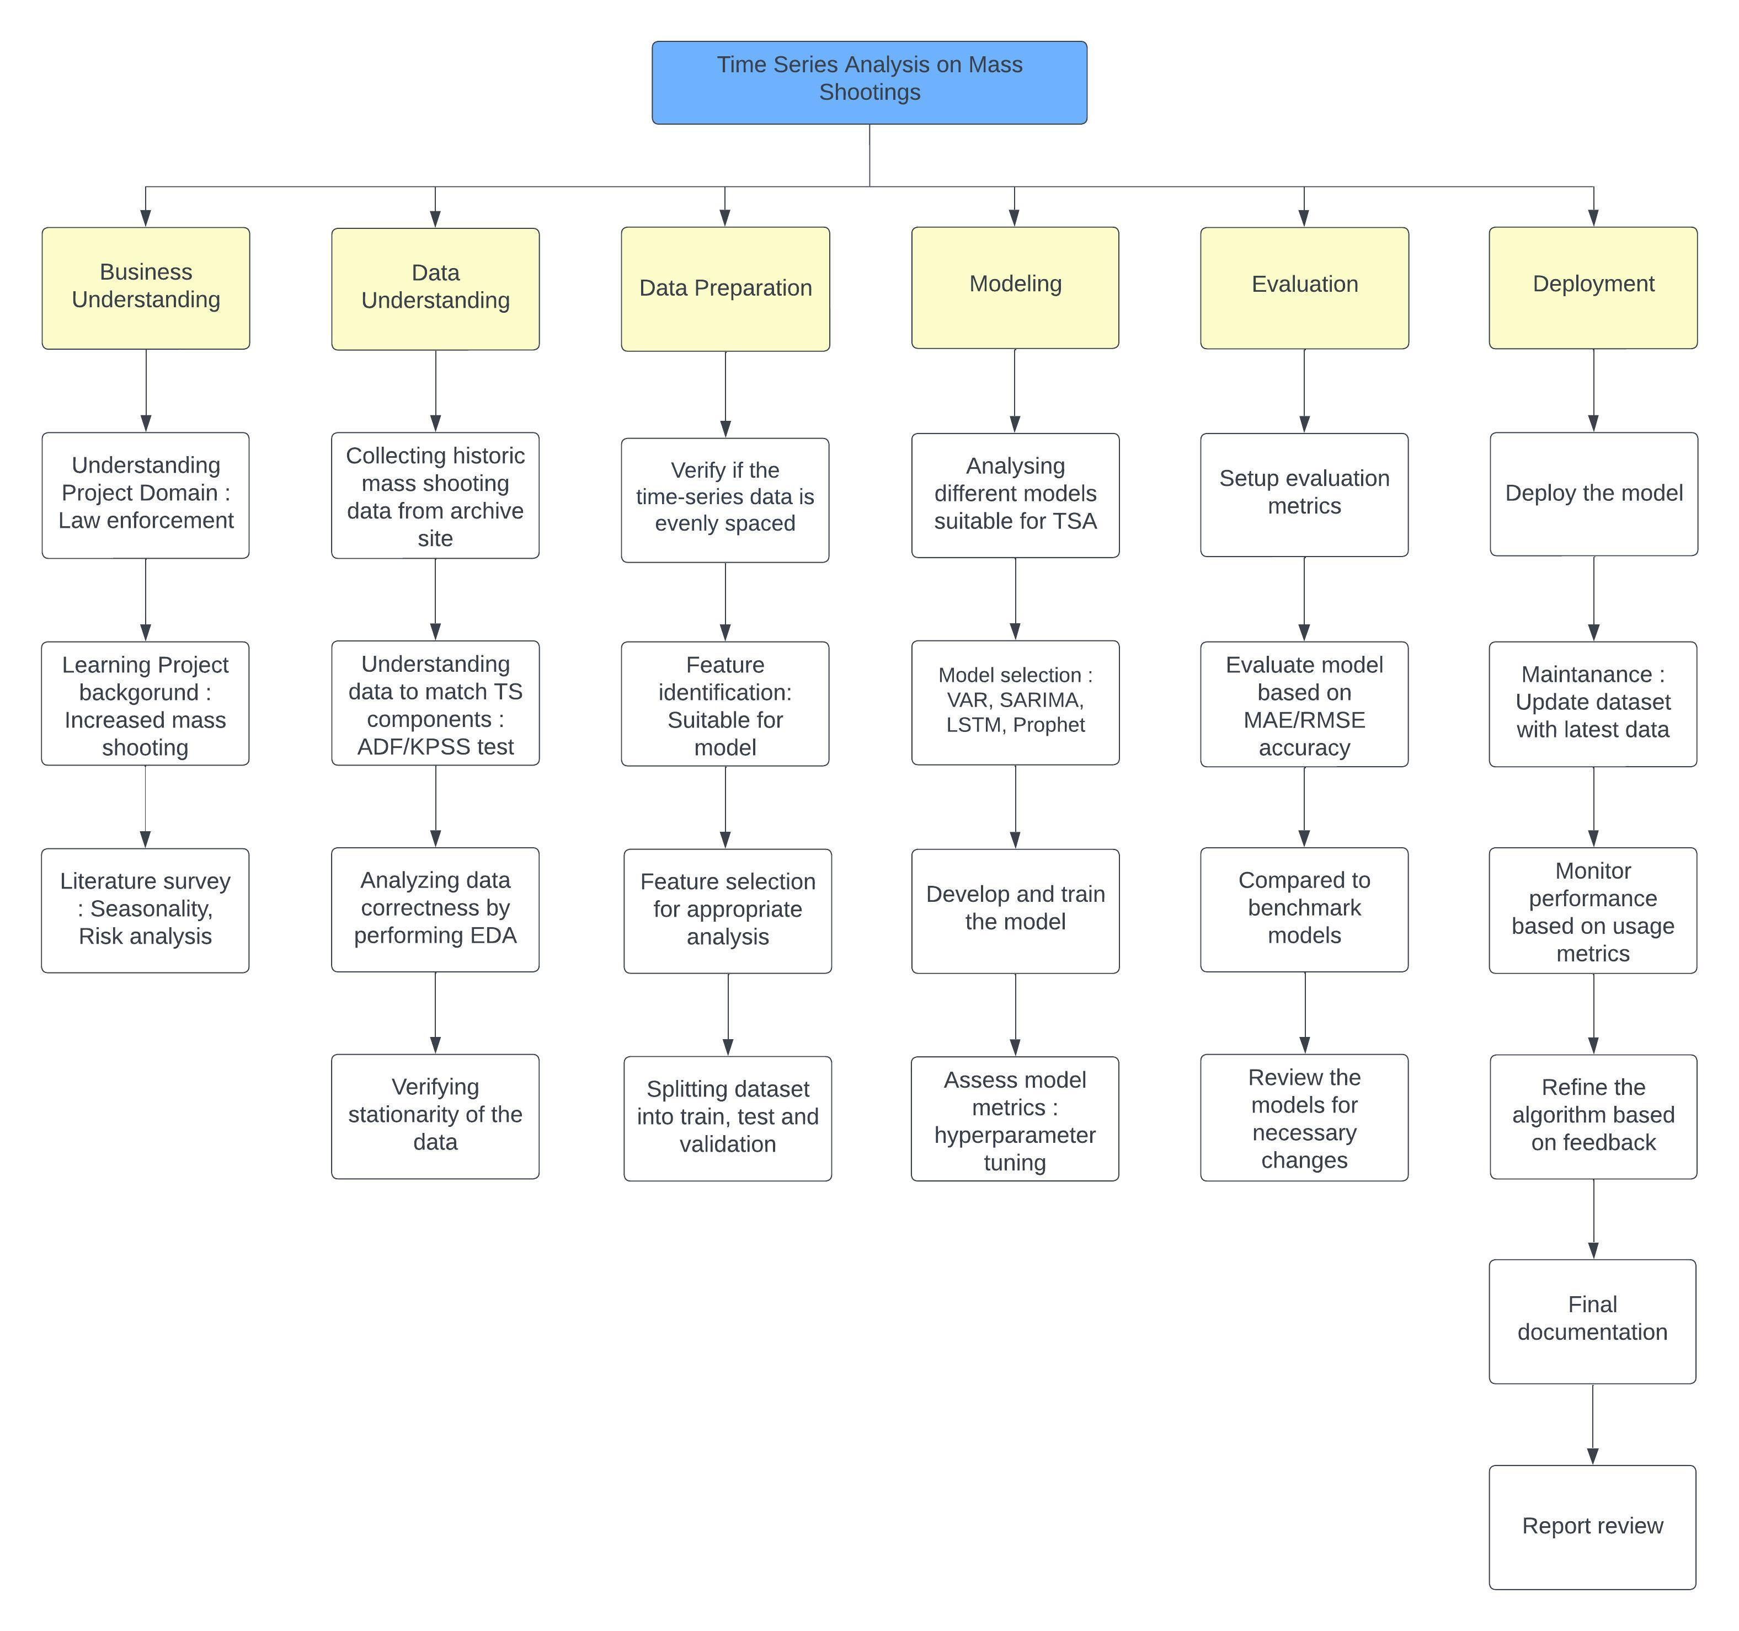




PROJECT PLAN

Slide 12
DATAFLOW
Managing noisy data
SARIMA
Dealing with partial & inadequate data
Combining the data
Managing data that are incompatible
Data regularization
LSTM
Mother jones & gun violence archive websites
Three Datasets
Combining the data
VAR
PROPHET
Feature engineering
Data Transformation
Data Preparation
Evaluation

Slide 13
PROJECT APPLIANCE REQUIREMENTS
 |  | HARDWARE REQUIREMENTS
Resource | Configuration | Purpose | Cost
Local Machine | Chip featuring an 8-core CPU, 8-core GPU, 4 performance cores and 4 efficiency cores 500 GB SSD, 16-core Neural Engine, with 16GB RAM | Processor required for Jupyter notebooks to run ML/DL models | 1200$
Google Collab Cloud Server | Intel(R) Xeon(R) CPU memory - 35 GB, op-mode(s): 32-bit | Company profits | Free

Slide 14
PROJECT LIBRARIES AND PACAKAGES REQUIREMENTS
 |  | LIBRARIES AND PACKAGES REQUIREMENTS
 | Library | Method | Usage
Dateutil | Dateutil.parser | parser | Dates from the dataset utilized for mathematical operations and data consumption ought to be parsed.
Pandas | pandas pandas.plotting | DataFrame, Series autocorrelation plot | visualization, manipulation, and time series analysis.
Matplotlib | Matplotlib.pyplot | pyplot | Used for data visualization and plotting
Seaborn | Seaborn | Seaborn | Used for creating statistical graphs
Scikit-Learn | Sklearn.metrics | Mean_squared_error | Used for model evaluation process

Slide 15
PROJECT TOOLS AND PLATFORMS REQUIREMENTS
 |  | TOOLS AND LICENSES
Tools | Purpose | License | Cost
Jupyter Notebook | Code development | Proprietary | Free
GitHub | Via web version system for oversight | Multiple | Free
Google Docs, slides | Word processing, spreadsheet, and presentation applications | Proprietary | Free
ClickUp | Software for problem monitoring and handling project | Proprietary | 150$
Zoom | For team meet ups | Free | Free

Slide 16
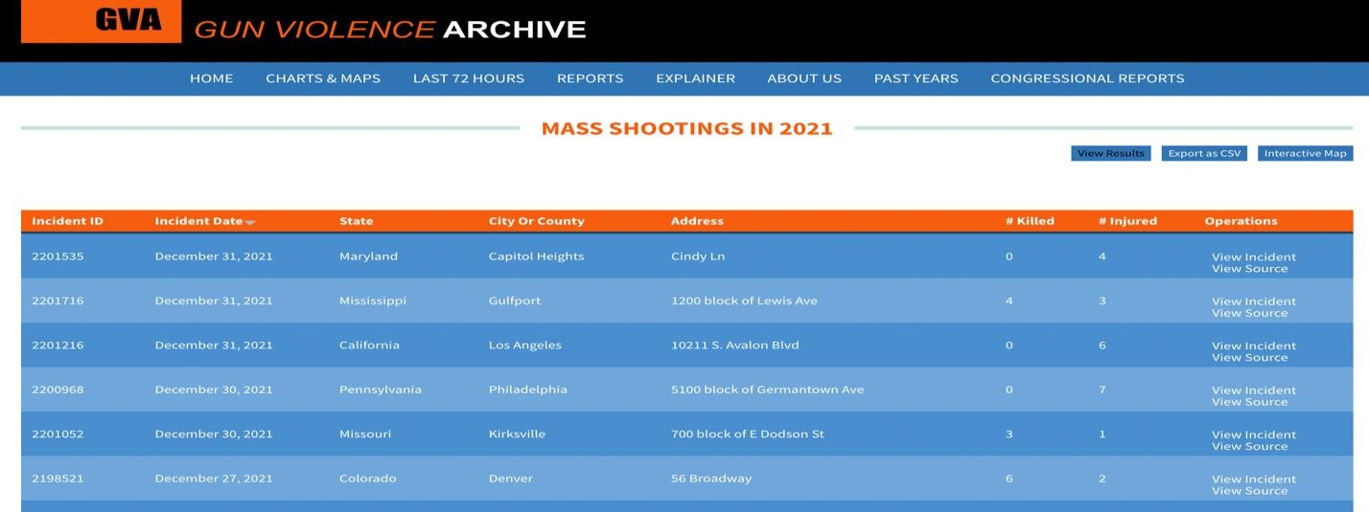
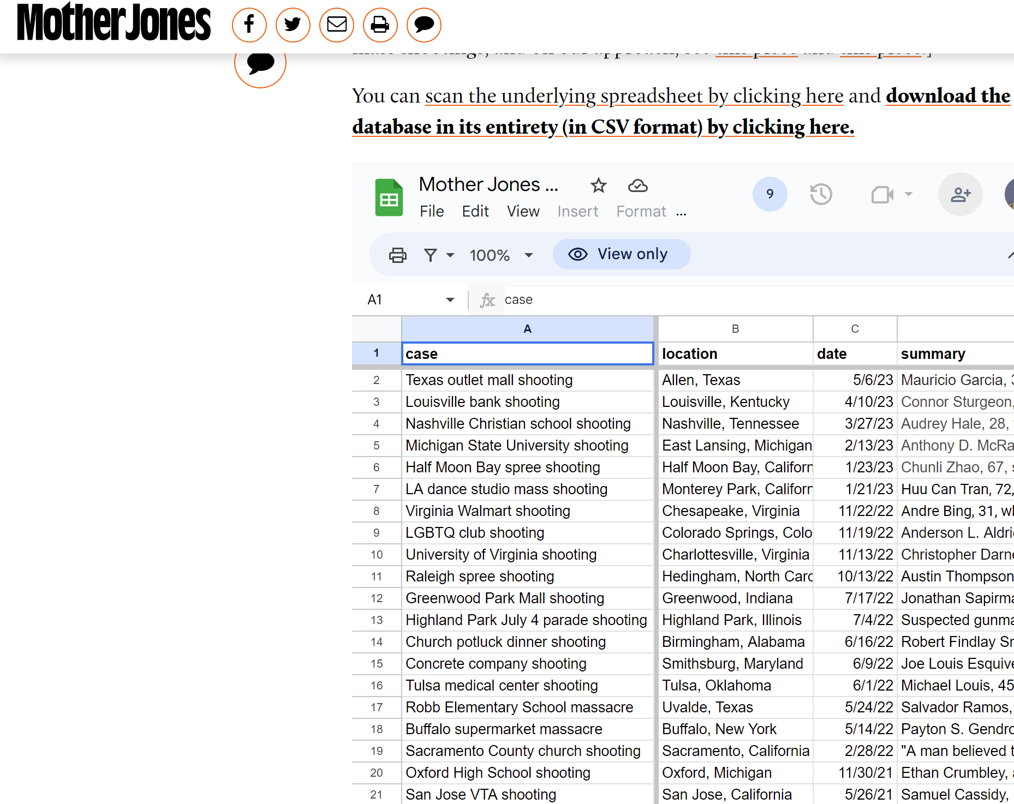
DATA COLLECTION
Data for the project was collected from websites such as Mother Jones and Gun Violence Archive.
The data was downloaded as separate CSV files for each year
The data obtained is accurate and up to date, gathered from various sources such as media, data aggregators, local, state, and federal law enforcement, and other sources on the internet.

Slide 17
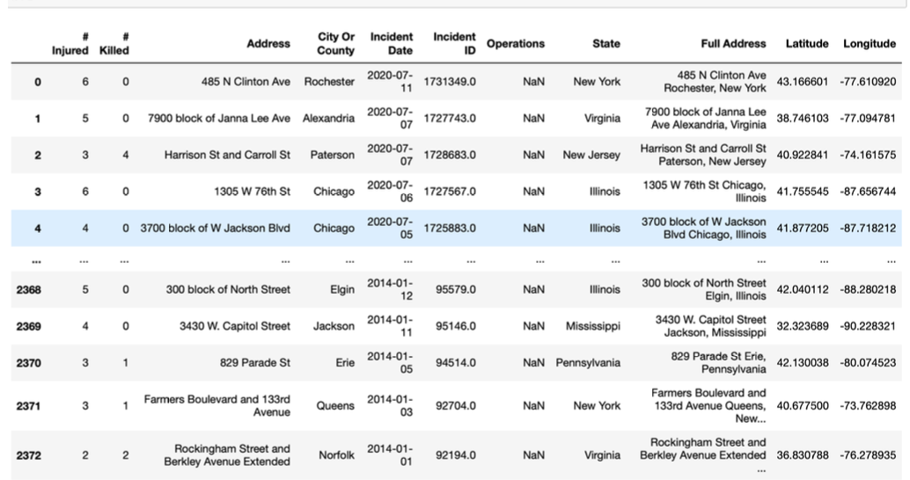
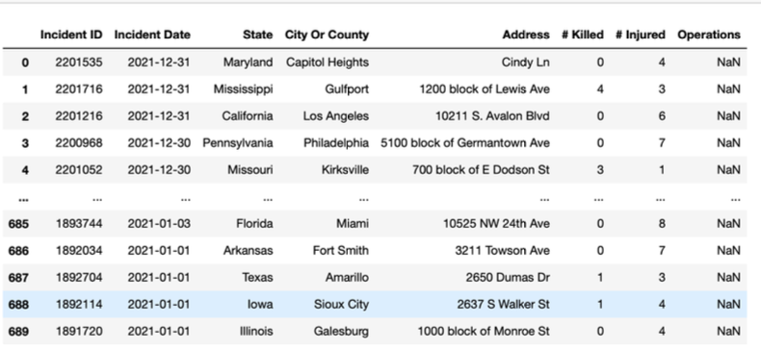
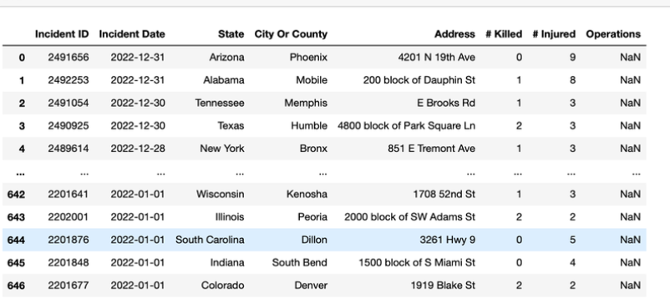
01
02
03
Dataset of 2021
Dataset of 2022
Dataset from 2014 -2020
RAW DATASET SAMPLES

Slide 18
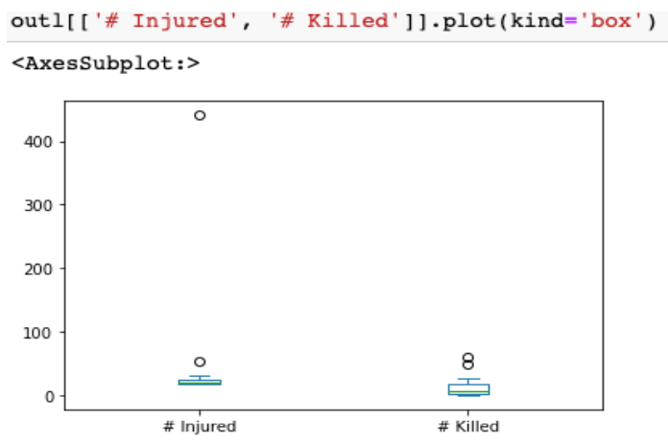
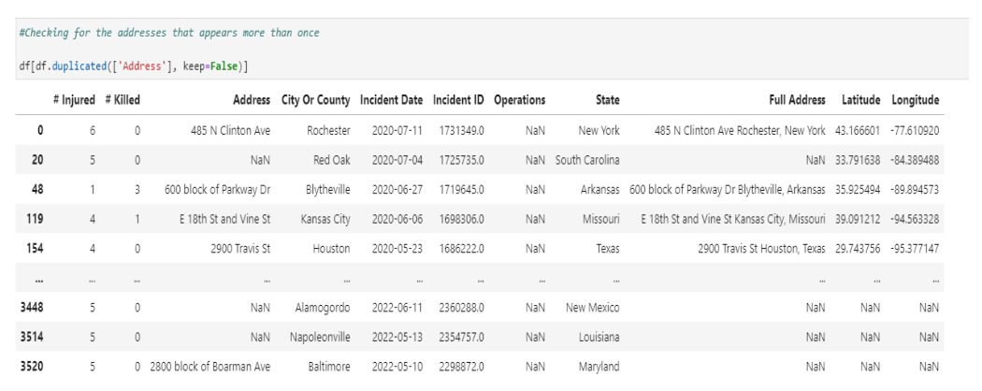
DATA PRE-PROCESSING:
The dataset contained 80 duplicate values in the Address column.
A box plot was used to visualize outliers in the data.

Slide 19
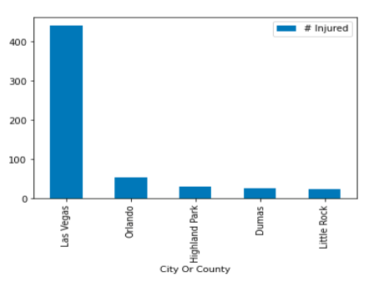
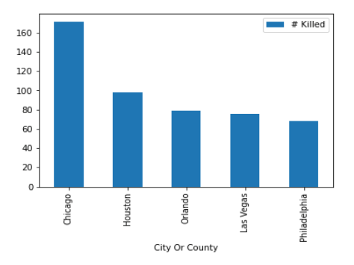
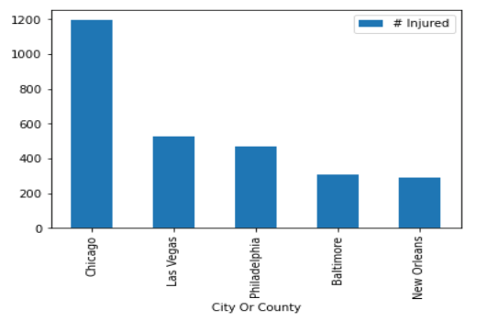
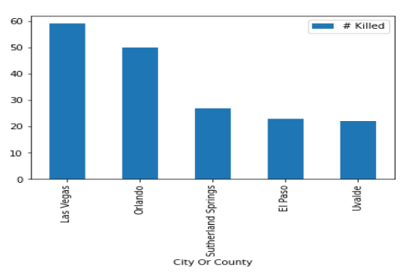
INCIDENTS THAT TOOK PLACE IN LAS VEGAS & ORLANDO
Bar chart were created to identify which city, had the highest number injured and killed.
Figure depicts the top 5 cities.

Slide 20
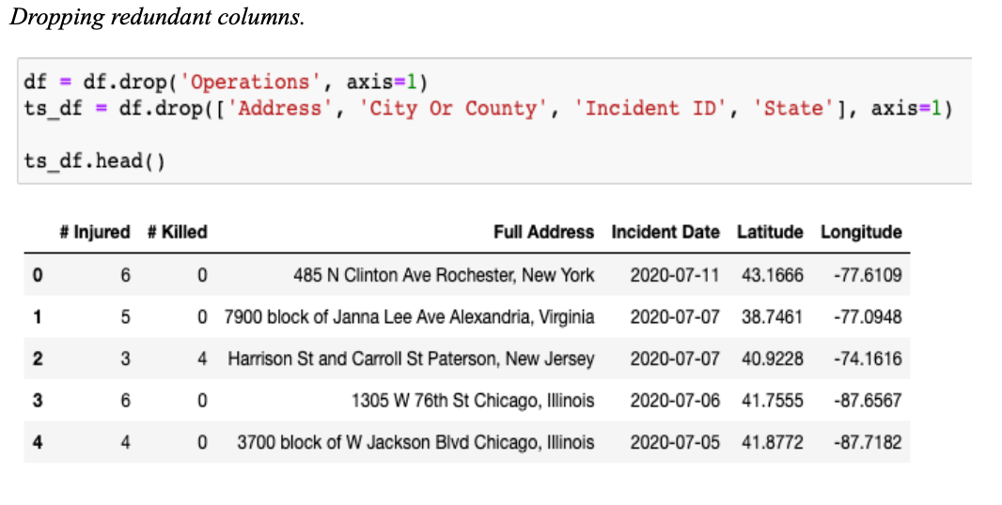
DATA WRANGLING AND VALIDATION
Data wrangling involves cleaning and preparing the data by removing unnecessary columns,
Addressing missing values and formatting it appropriately for analysis.
This process also includes detecting and removing outliers that may affect the model's accuracy

Slide 21
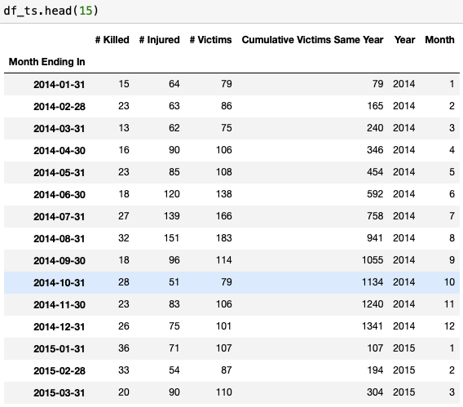
DATA TRANSFORMATION
Scaling and normalization standardize data for better analysis.
Converting into time series data having month, week as index.
Combining features to reduce redundancy in data.
Data transformation improves model performance by reducing noise, redundancy, and feature dominance, enhancing algorithm precision and effectiveness.

Slide 22
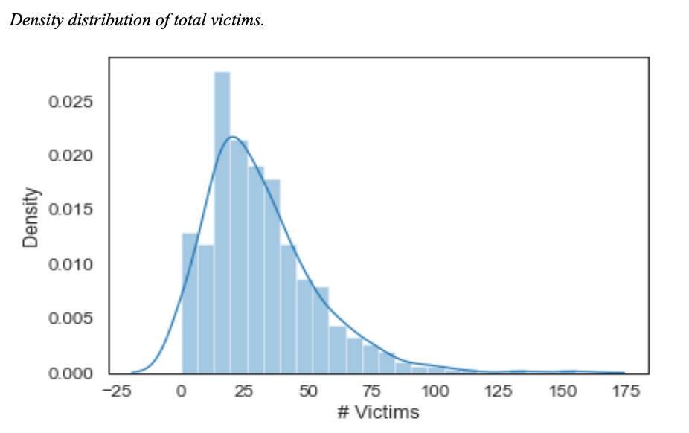
EXPLORATORY DATA ANALYSIS
A density plot was plotted to analyze the density distribution of victims using the seaborn library.
The mean of number of victims for all incidents reported are in range between 20 and 30

Slide 23
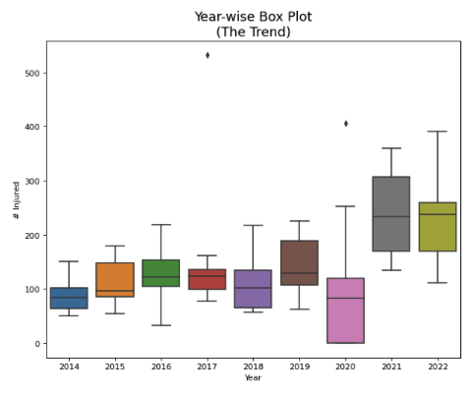
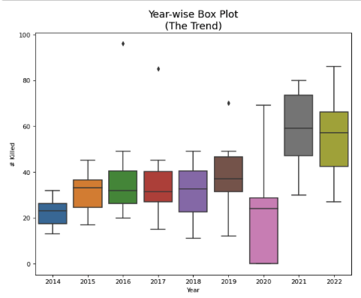
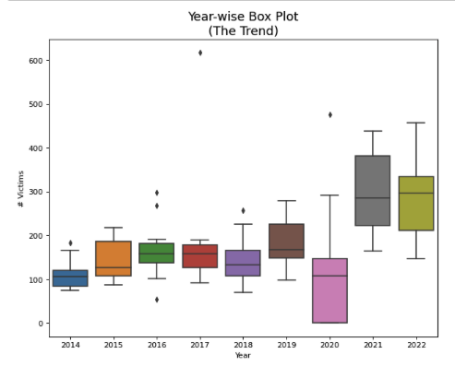
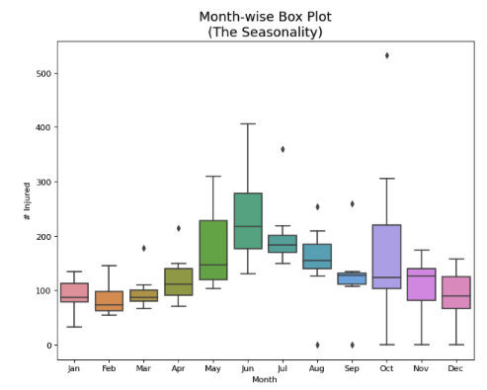
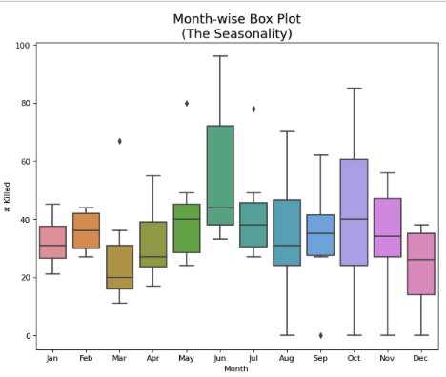
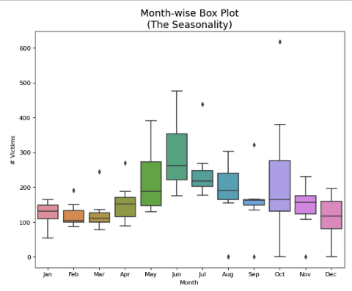
EXPLORATORY DATA ANALYSIS
Box plot of the Injured, Killed and Victims columns

Slide 24
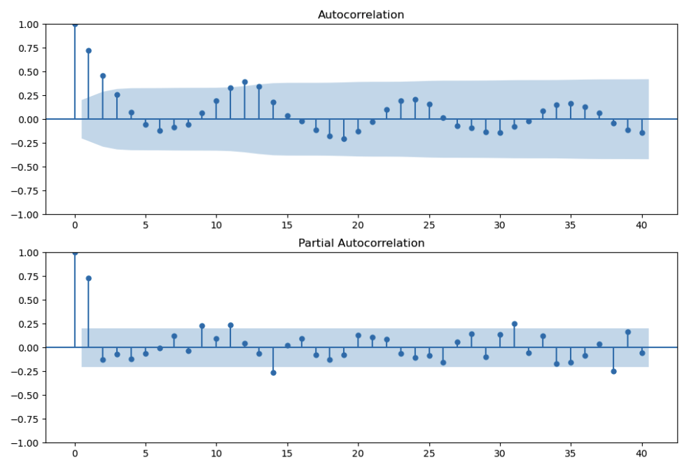
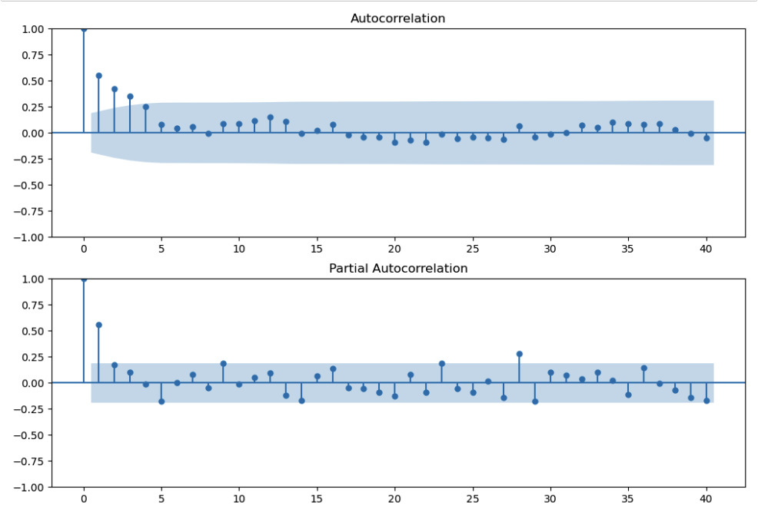
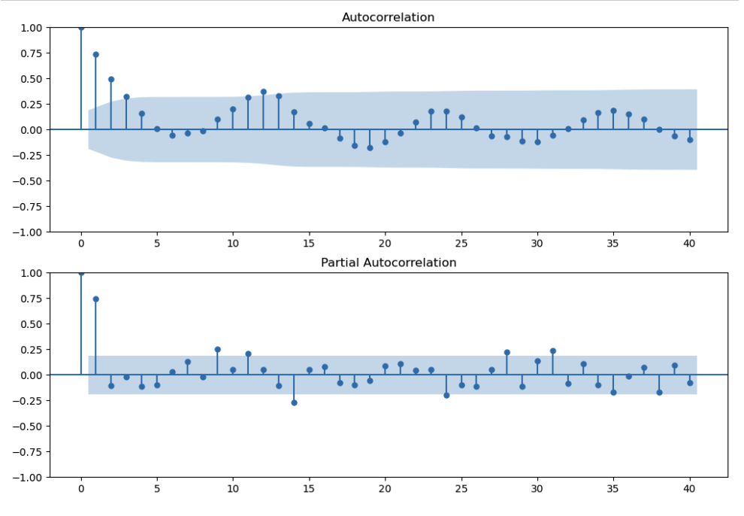
SEASONALITY CHECK
Autocorrelation and partial autocorrelation of the Injured column
Autocorrelation and partial autocorrelation of the killed column
Autocorrelation and partial autocorrelation of the victims column

Slide 25
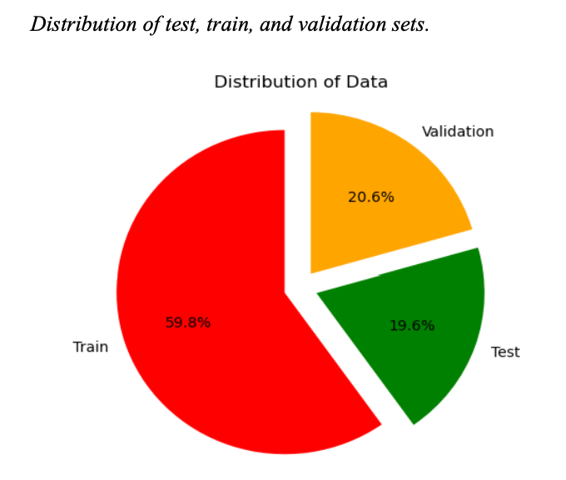

THE DISTRIBUTION OF TEST, TRAIN, VALIDATION SETS
The shapes of the test, train, and validation sets vary, and this can be visualized with a pie chart.

Slide 26
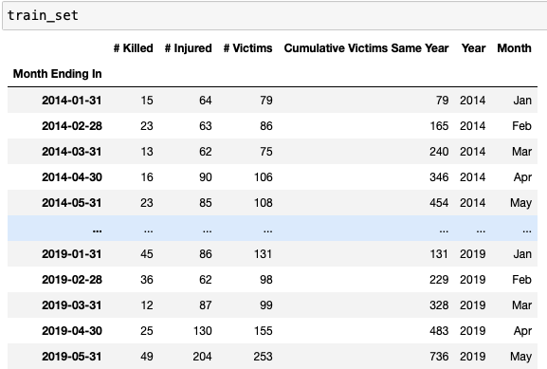
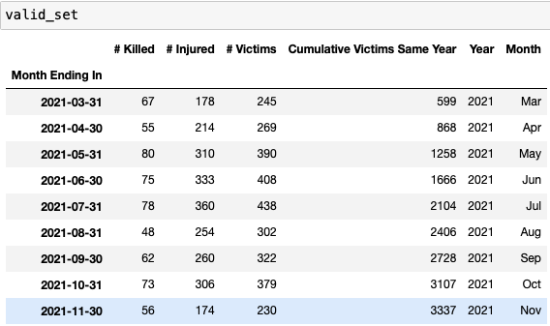
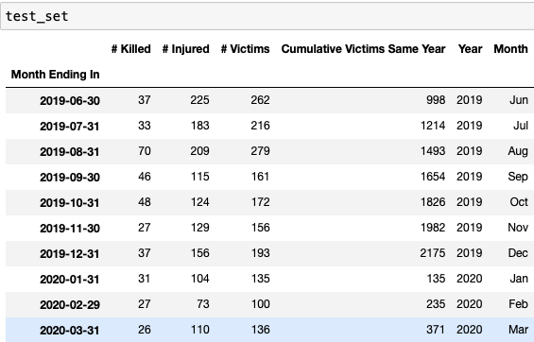
TRAIN, TEST, & VALIDATION DATASETS
Train Dataset
Validation Dataset
Test Dataset

Slide 27
MODEL JUSTIFICATION
MODELS | MODEL JUSTIFICATION
SARIMA | SARIMA (Seasonal Autoregressive Integrated Moving Average) models are well-suited for analyzing time series data with seasonal patterns, making them a suitable choice for investigating the occurrence of mass shootings over time. This model considers both the autoregressive and moving average components, as well as seasonal factors, allowing us to capture the cyclic nature of mass shooting incidents.
VAR | VAR (Vector Autoregression) models are suitable for analyzing multivariate time series data, making them valuable for studying mass shootings, which can be influenced by various interconnected factors. By incorporating multiple variables, such as social and geographical factors, into the analysis, VAR models can capture the complex relationships and interactions between these factors, providing a comprehensive understanding of mass shooting dynamics.
LSTM | LSTM (Long Short-Term Memory) models are a type of recurrent neural network (RNN) that excel at capturing long-term dependencies and complex temporal patterns in time series data. Mass shootings, with their intricate dynamics and varying temporal dependencies, can benefit from the powerful memory and sequential processing capabilities of LSTM models.
PROPHET | Prophet is a specialized time series forecasting model developed by Facebook that can handle seasonality, trends, and outliers in the data. This makes it well-suited for analyzing mass shootings, which exhibit distinct seasonal patterns and trends over time. Prophet simplifies the forecasting process by automatically detecting and incorporating multiple components, such as yearly, weekly, and daily seasonality, along with holiday effects.

Slide 28
MODEL COMPARISON
Model Name
MAE
RMSE
SARIMA
57.46
70.92
VAR
99.41
122.29
Prophet
64.86
86.49
LSTM
25.36
34.45

Slide 29
CONCLUSION & FUTURE SCOPE
The study found that mass shootings display a solid seasonal and periodic pattern, with notable peaks in the summer and fall every year.
A peak after the recent period of low activity during the pandemic
The models provide valuable insights into the phenomenon's temporal patterns and potential drivers, helping law enforcement agencies and crime research institutions to forecast crime rates and assist in resource allocation.

Slide 30
THANKS!
Do you have any Questions?

